Slide 1

















Project presentation
Smart IT Exit Exam Portal
Under supervision
Dr. Muhammad Ashour.
Eng. Menna Hosny

Slide 2
Students participating in the project
Student Name | ACADEMIC ID
Joseph Magdy Habib | 2001666
Mostafa Yasser ElSayed | 2000506
Akram Hosny Helmy | 2001770
Mahmoud Karam Mahmoud | 2001893
Ahmed Yasser AbdElazem | 2001702
Ahmed Nasser AbdElarouf | 2001712
Eyad Hesham Ahmed | 2001206
This Graduation project was Made By Center Hurghada

Slide 3

Content of Presentation
02
04
06
Problem Statement
Software Specifications
Project modules
01
03
05
07
Objectives
User Characteristics
Project
Scope
Conclusion
&
Future Work

Slide 4


01 :Objectives of Online Exam Portal:
develop Online Examination System.develop Teaching .
provide an efficient platform both for the students and the instructors.
provide a website which will reduce the time required to give the exam and know the results.

Slide 5

02:Problem Statements:
Online examination helps students is to offer a quick and easy way to appear for the exam Through internet.
Presently, if the instructor conduct any test, they have to check the answer sheets manually which is time consuming and the generation of results manually might result in errors.
This project provides time limit to finish the exam.
The user can see their results after completing the exam by instructor.

Slide 6



03:Project Scope of Online Exam Portal:
Online Examination system is designed for Educational Institutions ( colleges, universities For IT Students Level 4 ).
provide better security. Main goal to test students by 3 levels difficulty (easy –moderate –hard)and see weakness points Of Students and resolve it.
It can be used anywhere any time as it is a web based application.
It reduces the time of taking examinations of the students manually.
Allows students to check correct answers after the examination .and test grade and points for each questions

Slide 7




04:Software Specifications:
XAMPP Software
Model
View
Controller
Software
Other
Language
MVC
MVC
HTML
CSS
JAVA SCRIPT
Bootstrap J Query
PHP
MySQL
Programming Language
Database

Slide 8
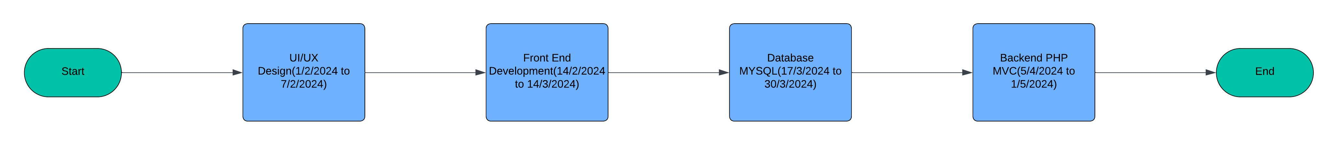
04:Agile & Planning Milestone

Slide 9
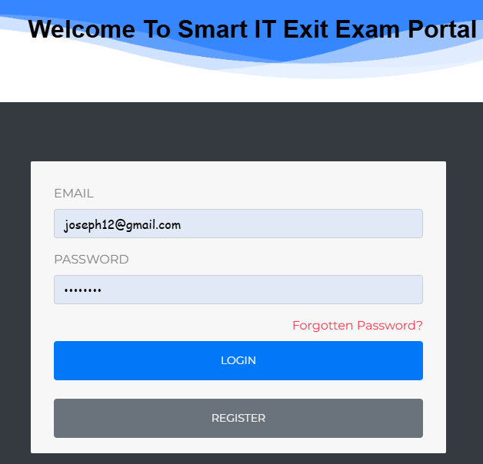
1/Login Account Module ?
1. User Authentication Identify :
Instructors and Admins can log in using this form by entering their email and password.
Admins are authenticated based on specific credentials that verify their admin status.
The system checks the entered email and password against the database to ensure the credentials are correct and that the user has the appropriate access level (admin or instructor).
2. Login Process:
Email Field: Users must enter their registered email address. This is used to identify the user in the system.
Password Field: Users must enter their password. The system hashes this password and compares it with the hashed password stored in the database.
3. Forgotten Password:
If a user forgets their password, they can click on the "Forgotten Password?" link.
This link typically directs the user to a password reset process where they can enter their registered email address.
The system then sends a password reset link or a temporary password to the user’s email address on file.

Slide 10
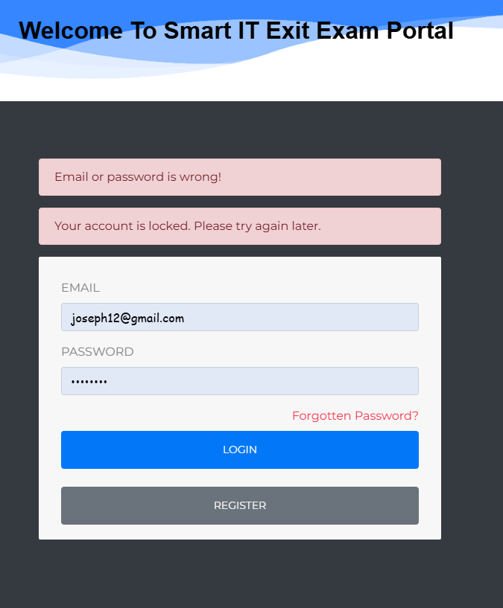
1/ What is the feature of login that is not available on other platforms?
1. Improved Security
Prevent Brute Force Attacks: By disabling the form submission after multiple failed attempts, you make it significantly harder for an attacker to use automated tools to guess the correct password.
Prevents Credential Stuffing: Attackers often use stolen username-password pairs from other sites to gain access. Disabling the form helps reduce the effectiveness of such attacks.

Slide 11
1/What is the feature of login that is not available on other platforms?
1. Improved Security
Reduces Account guess Risk: By stopping further attempts, it minimizes the chances of an attacker guessing the correct login credentials.
Password Reset: Users are more likely to use the "Forgot Password" feature after realizing their account is locked, which helps ensure they regain access through a secure process.
User Trust: Knowing that their account will be locked after multiple failed attempts can increase user trust in your platform's security measures.

Slide 12




2/ Advantage Examination Module
The answer will save automatically if student forget click on submit test or the time limited is finish ;make save also .
We make a alert to student before the time limit finish to make a submit and solve quickly .
Student can see all details of result of test through pie chart how many question is correct and wrong and see the accept answer.
When the student starts the exam the timer will start automatically and show the student how much time is left.
can back to previous question after solved it .

Slide 13



3/Dashboard Module
Only administrators and instructors can access this module. In this module, administrators and instructors can view student details, marks reports, examination reports, and more. The module provides facilities to add student details, view the student list, and edit student details. Additionally, administrators can manage user details, course details, and subject details.

Slide 14






4/Question Bank Module
Questions bank will have a program to add, modify
and delete questions from subject. Here Instructor can
add any type of questions manually by writing and can add fixed questions was created on previous tests by clickable and select the question and make assign .

Slide 15
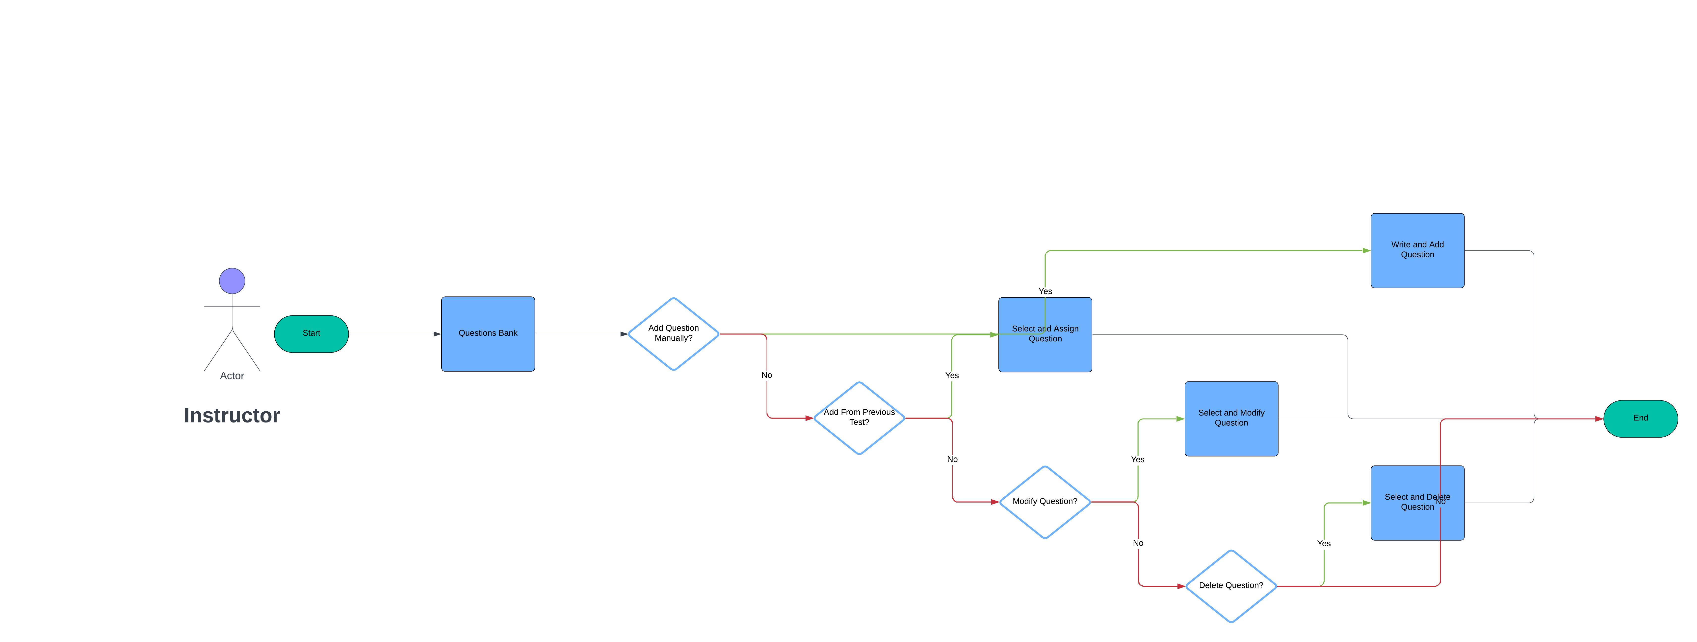
4/Question Bank Module Flow Chart

Slide 16

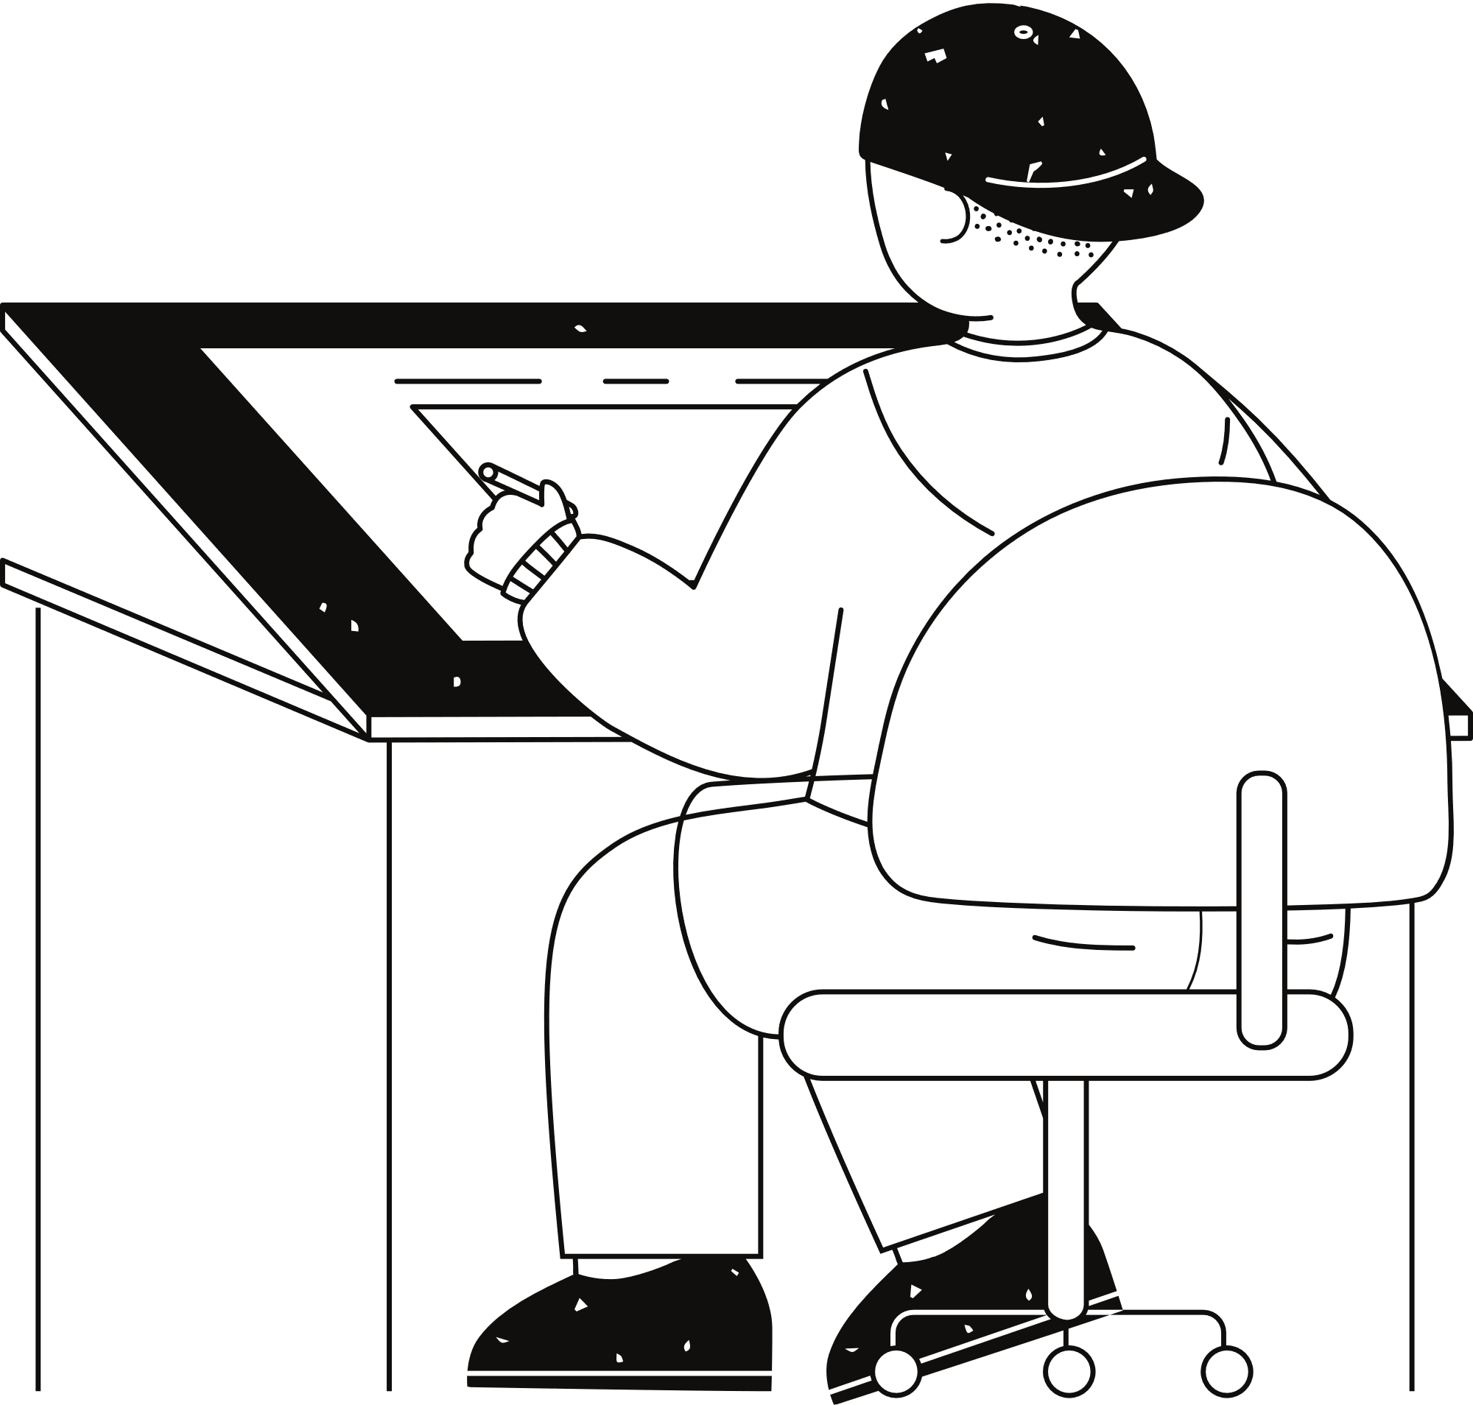
05:User Characteristics:
There are 3 kinds of users in the proposed system.
1-Admin: The administrator is the main user of the system, and he can control complete website.
2-instructors : instructors of each course will prepare questions and its options and loaded into the software.
3- Student: The student will login to the system and take his/her test
The student will get result immediately after the completion of the examination.

Slide 17

Admin DETAILS:
1.REGISTER: To be authenticated first have to be registered.
2.LOGIN: The Registered User Can be Allowed to view inner details for which he Permitted privileges .
3.CHANGE PASSWORD&FORGOT-PASSWORD: User has rights to modify his login details & also be informed through mails if he is unable to login.
4.STUDENT -MODIFING DETAILS: User can be modified to change status of each User. ( ADD - Suspended – reactivated – remove ).
5.INSTRUCTOR DETAILS-MODIFYING DETAILS: According to staff he can add or Suspended Instructors or remove.
6. Can view results and download it and can update his profile (Name – Email – Phone – password ).

Slide 18
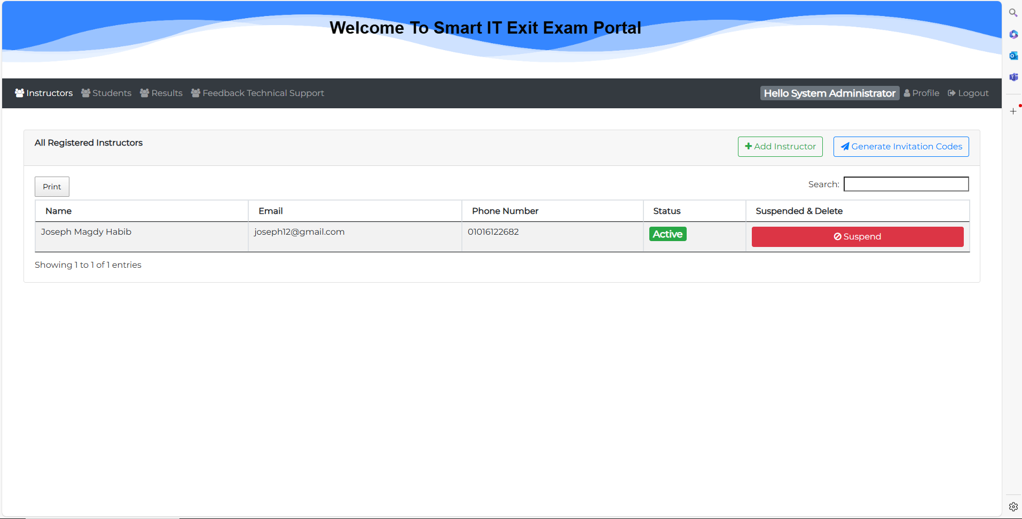
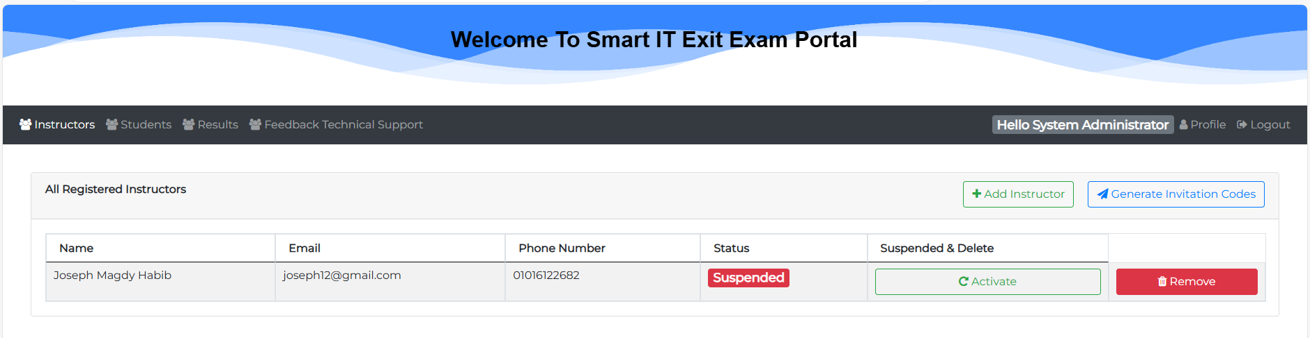
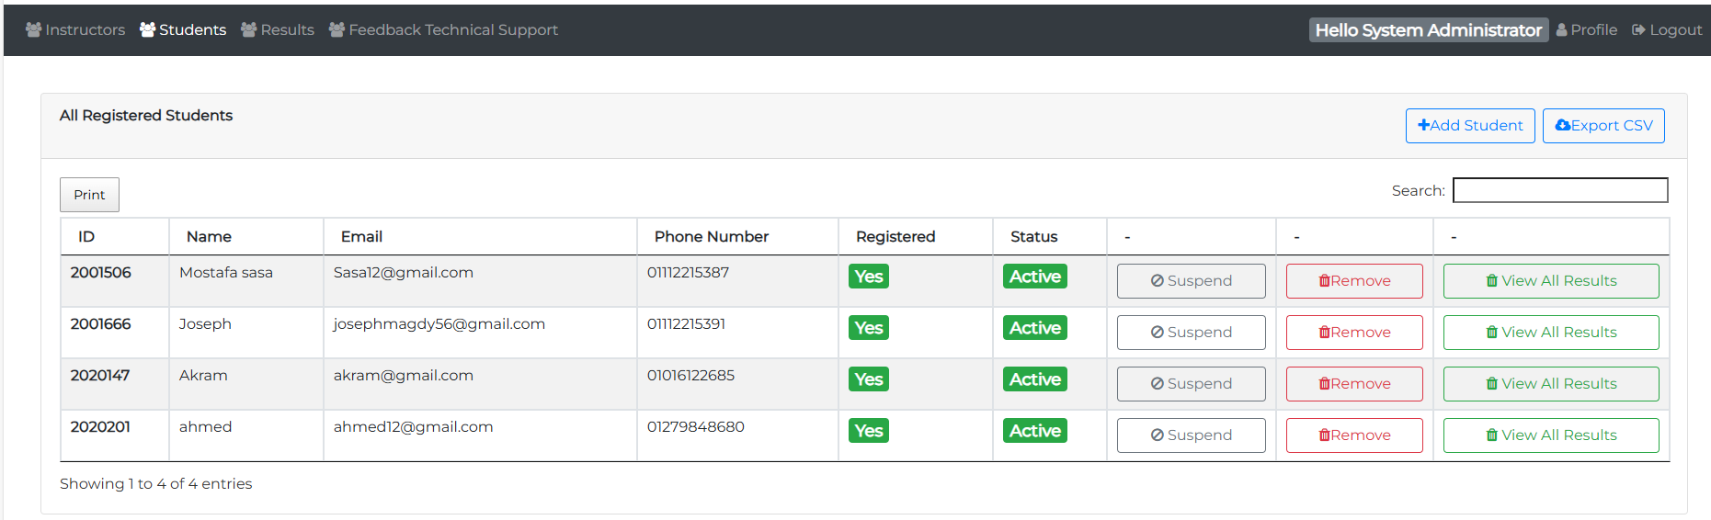
Admin Outputs:

Slide 19
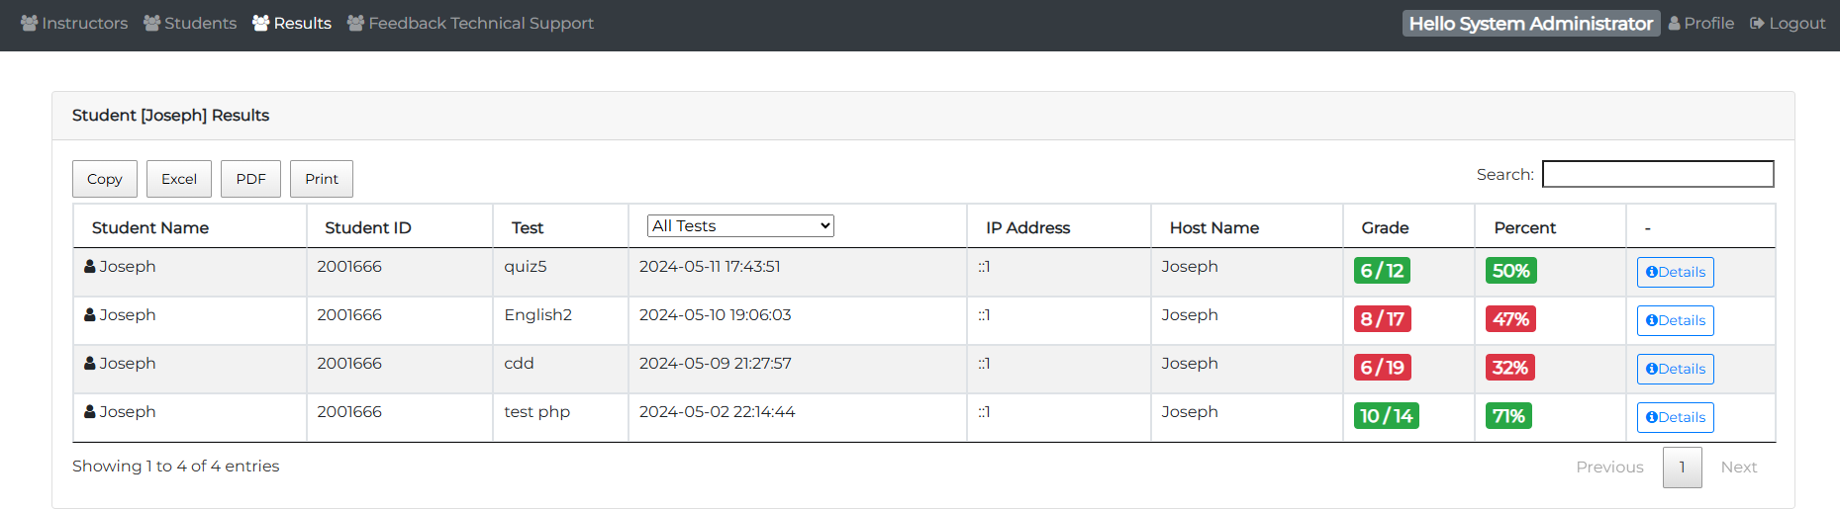
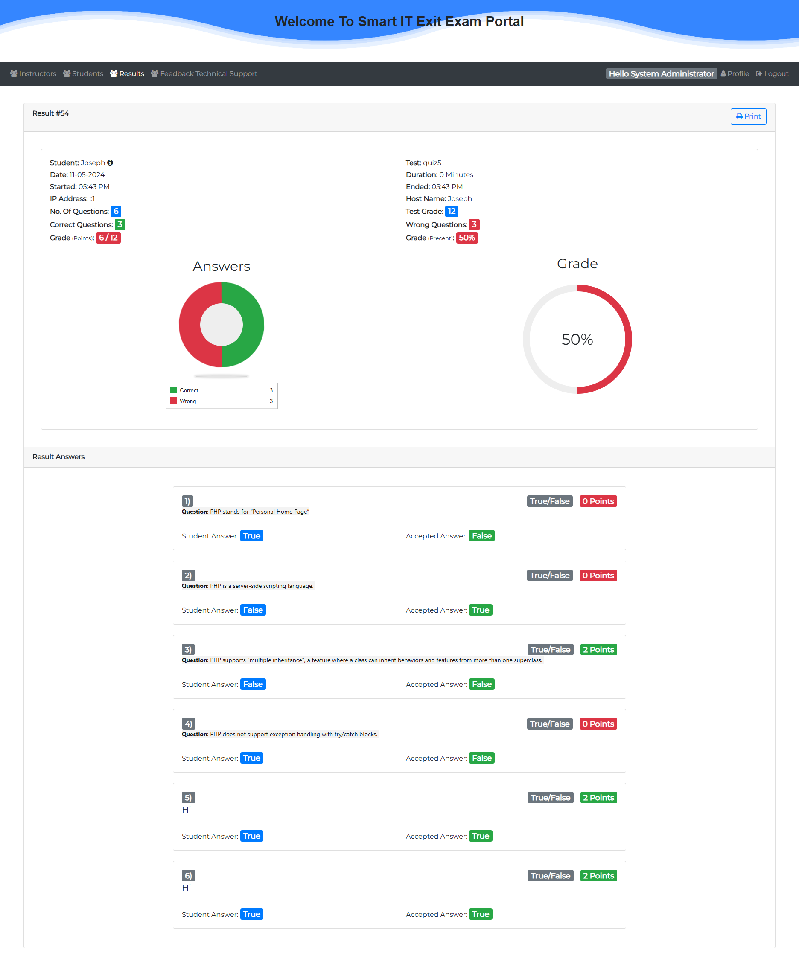
Admin Outputs:

Slide 20
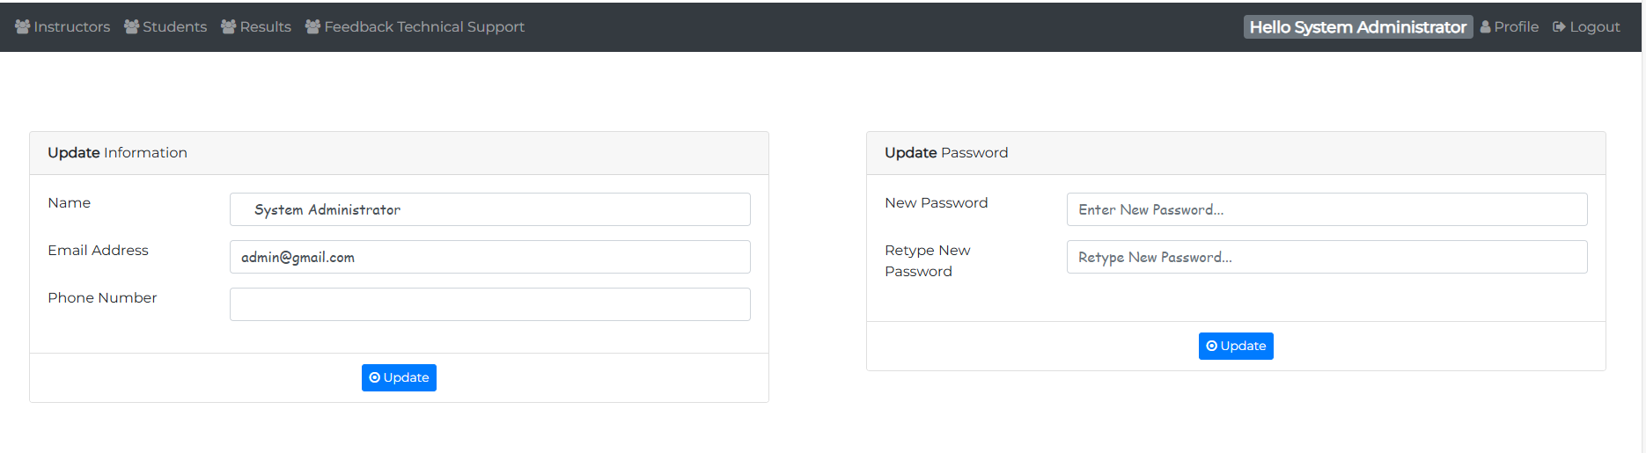
Admin Outputs:

Slide 21
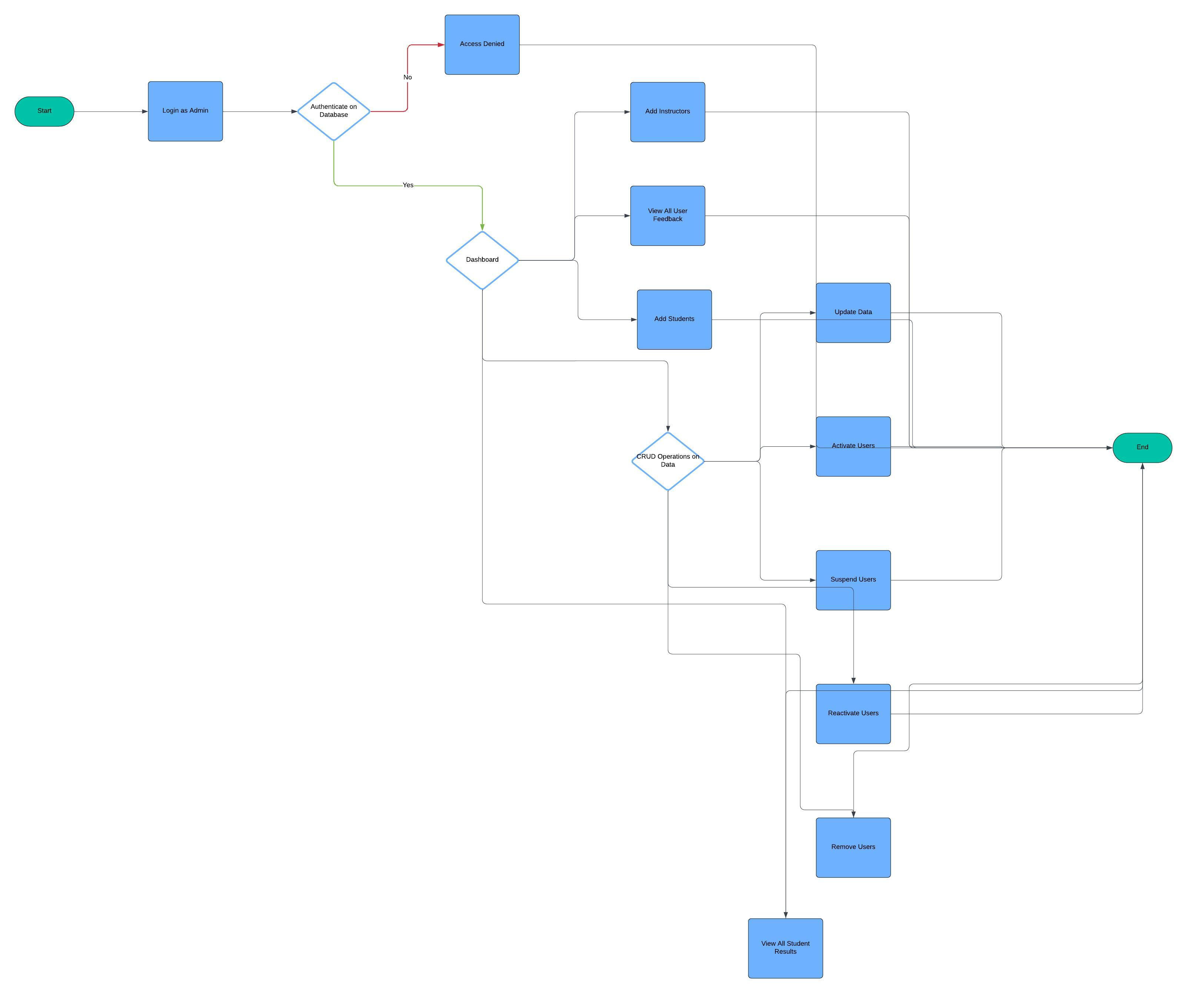

Admin FlowChart:
Click Here

Slide 22
INSTRUCTOR DETAILS:
1.REGISTER : To be authenticated first have to be registered.
2.LOGIN : The Registered User Can be Allowed to view inner details for which he Permitted
3.CHANGE PASSWORD&FORGOTPASSWORD :User has rights to modify his login details& also be informed through mails if he is unable to login
4. Add a course and his topic (Title of lecture ).
5. Make a group study and generate codes to student join by code or added by ins
6.ADD QUESTIONS-DEPARTMENTS VERIFING :According to flow of questions & Technology he can add questions into the database.
7.UPDATE QUESTIONS : If any corrections in data of questions he can modify them
8.CREATE EXAMS : He will be prepared schedule for exams
9. Assign a test & exam to groups And VIEW EXAM DETAILS- VIEW NO OF REGISTERED STUDENTS
Click Here

Slide 23
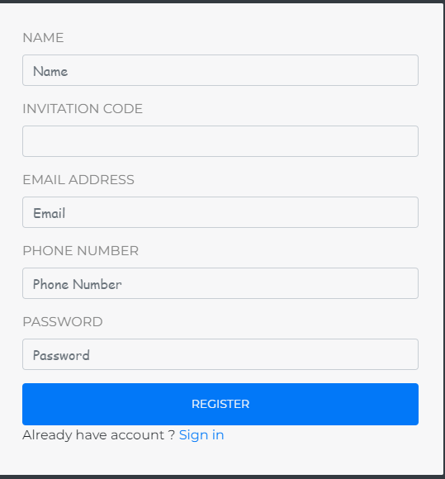
instructor Outputs:
Register
Click Here

Slide 24
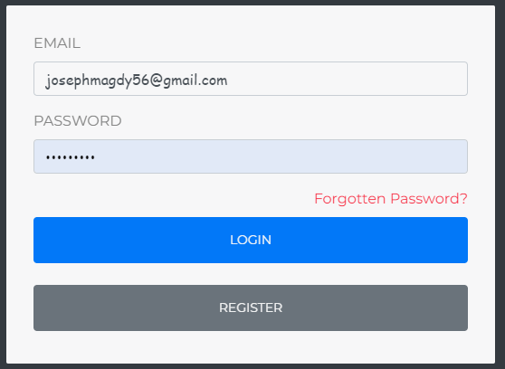
instructor Outputs:
Login
Click Here

Slide 25
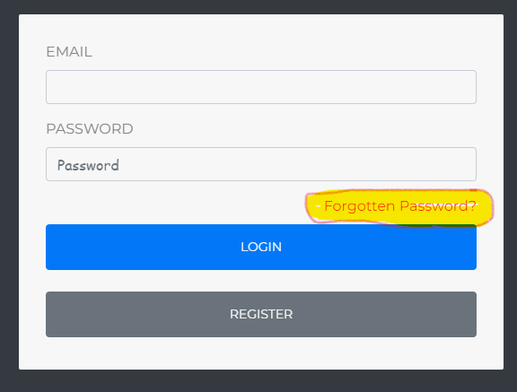
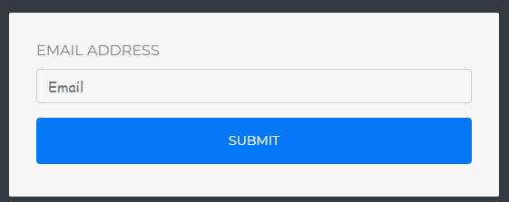
instructor Outputs:
CHANGE PASSWORD&FORGOTPASSWORD
Click Here

Slide 26
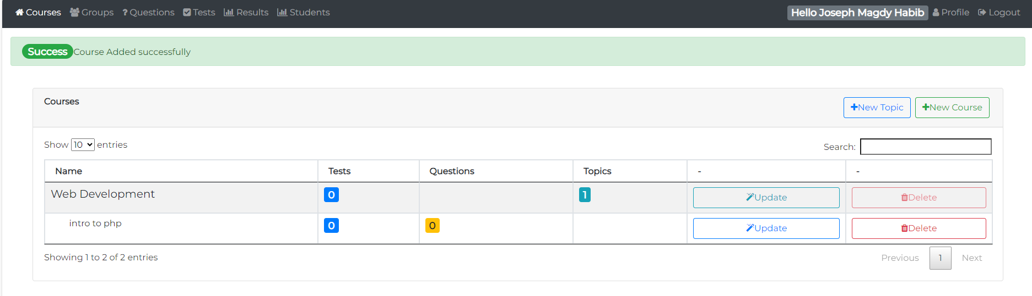
instructor Outputs:
Add course and his Topic
Click Here

Slide 27
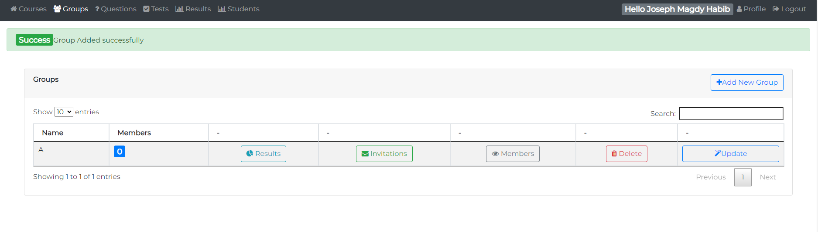
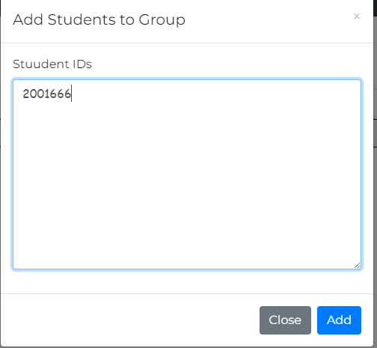
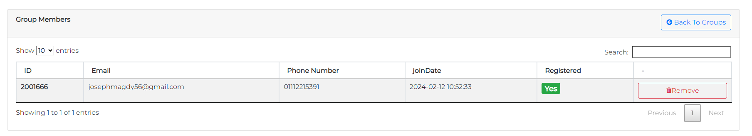
instructor Outputs:
Add groups then make add student
Click Here

Slide 28
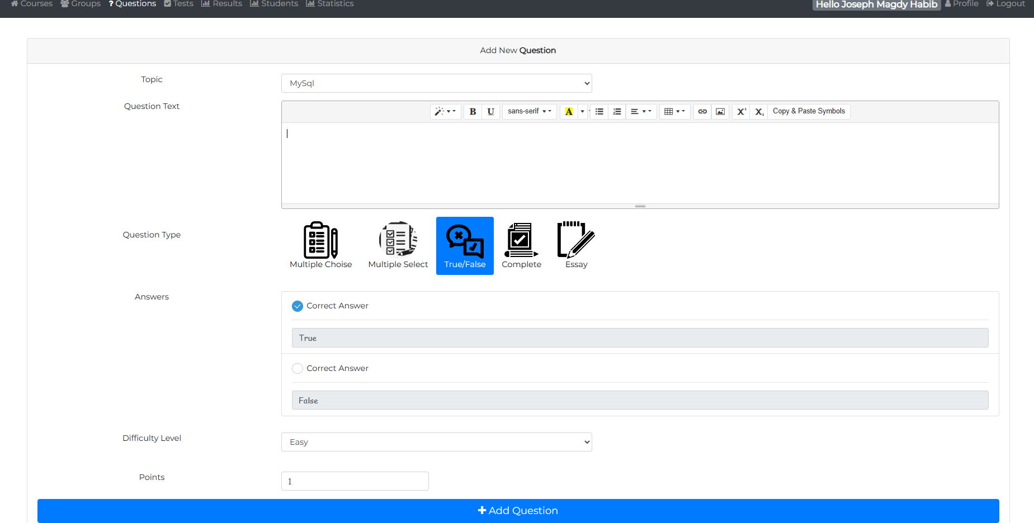
instructor Outputs:
ADD QUESTIONS
Click Here

Slide 29
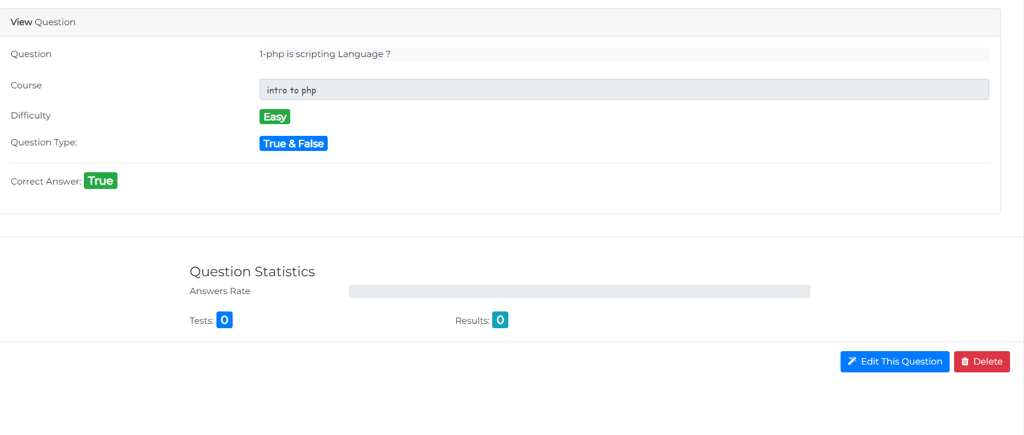
instructor Outputs:
Update or edit
Click Here

Slide 30
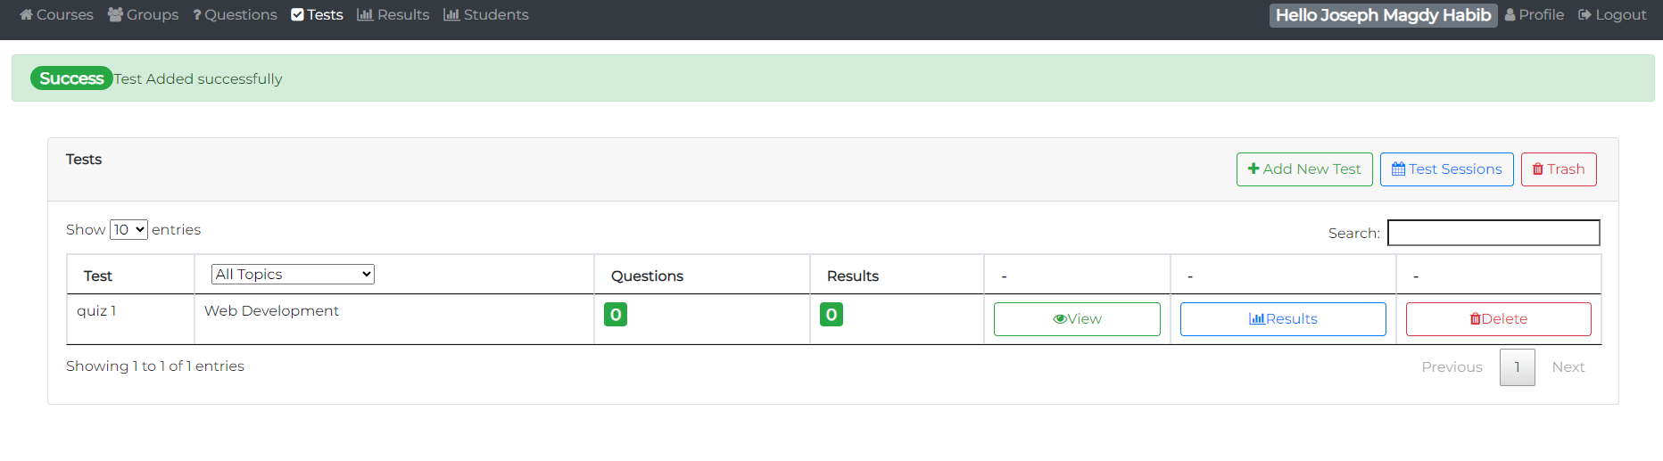
instructor Outputs:
Create a test & exam
Click Here

Slide 31
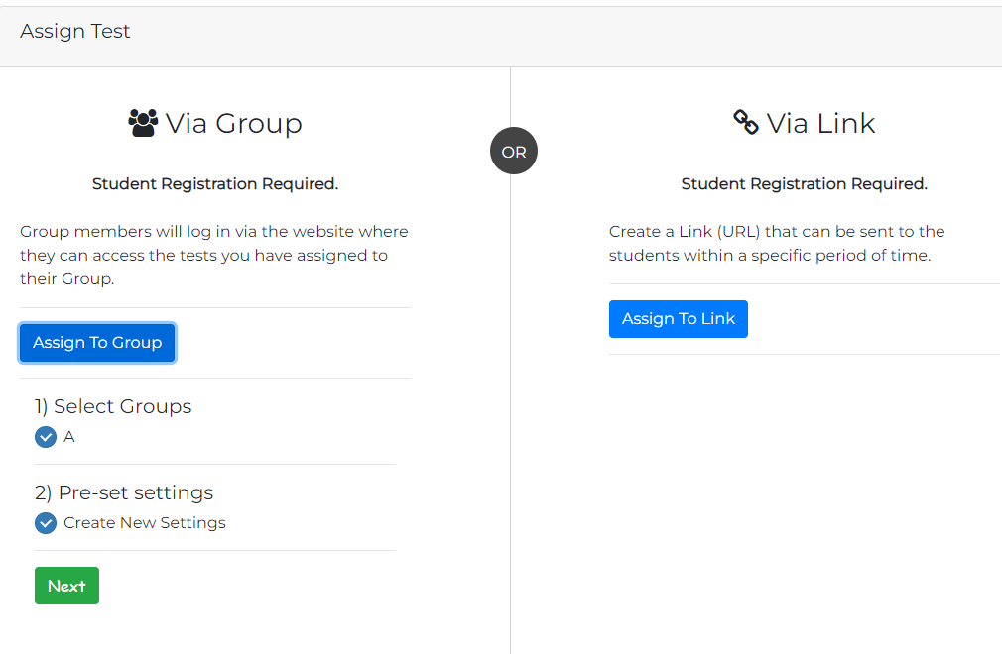
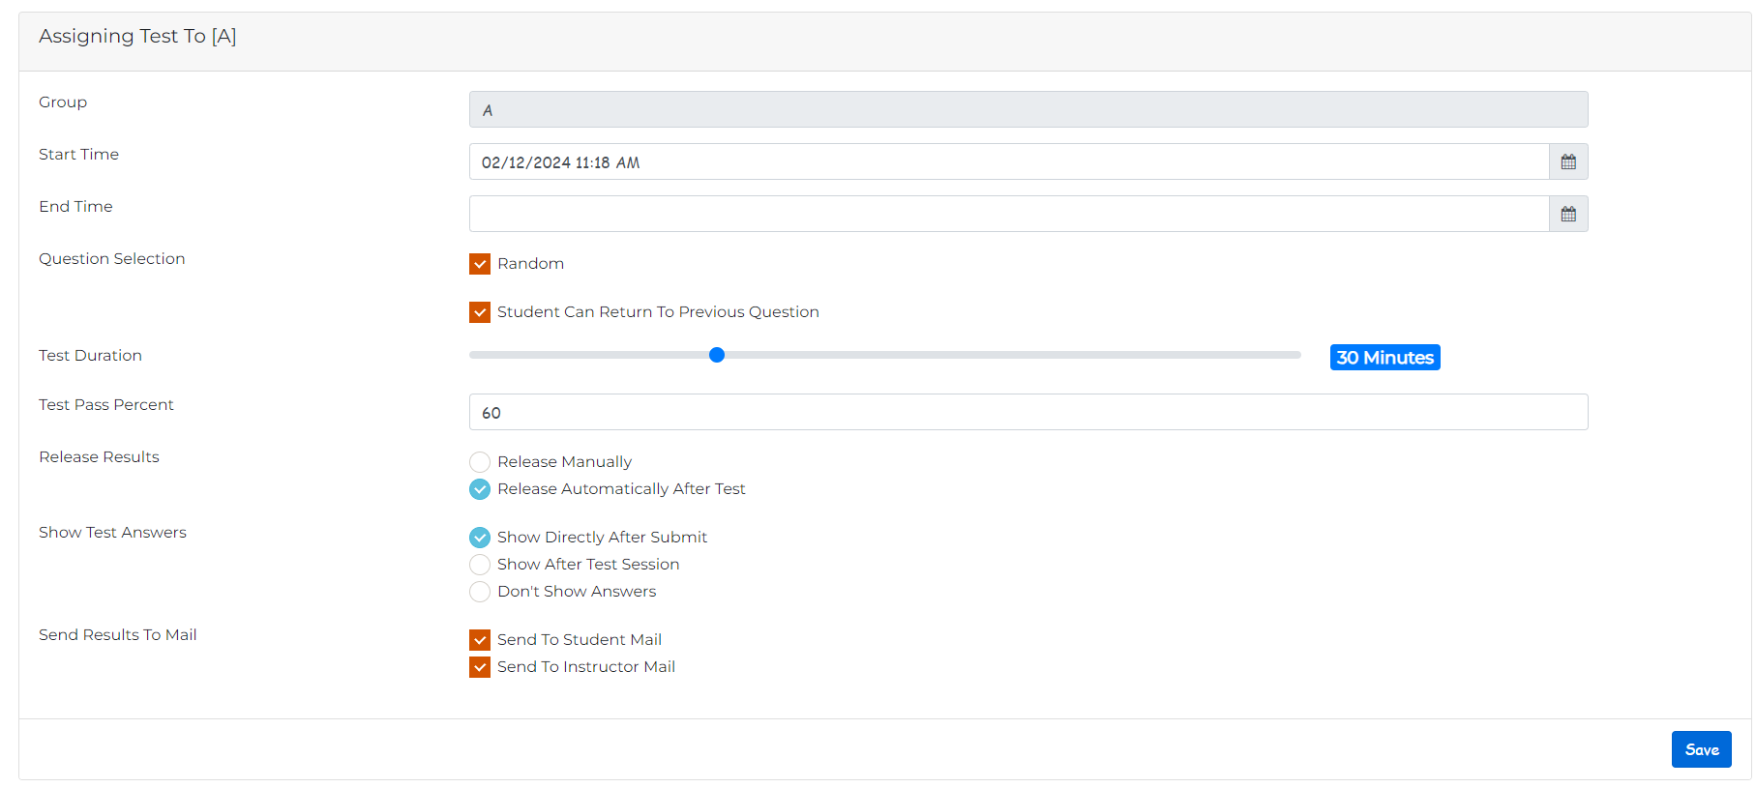
instructor Outputs:
assign a test & exam to groups
Click Here To Student

Slide 32
STUDENT DETAILS:
1.REGISTER:To be authenticated first have to be registered.
2.LOGIN:The Registered User Can be allowed to view inner details for which he
Permitted.
3. Forget Password and renew password by email .
4-Can see his Group: Student can join group when instructor add it
5- update profile : Student can update profile (Phone – his email – his password )
6.TAKE EXAM- MULTIPLE CHOICE ,Essay, TRUE/FALSE: The registered student allowed to start the exam.
7- Solve the exam on test session durations
8. SEE EXAM RESULTS :After Completion of exam he can view at his result..

Slide 33
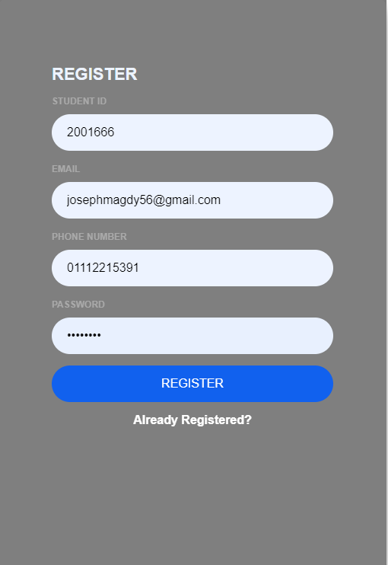
STUDENT OUTPUTS:
Click Here

Slide 34
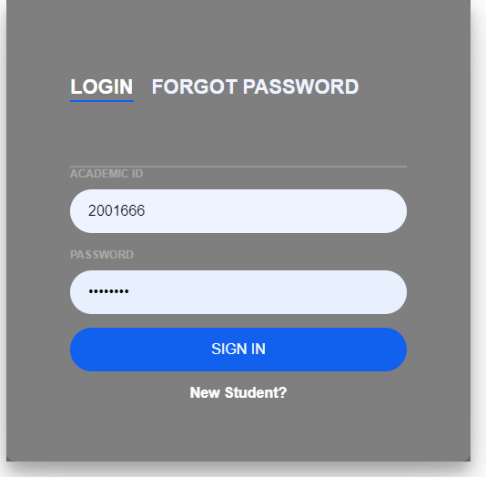

STUDENT OUTPUTS:
Click Here

Slide 35
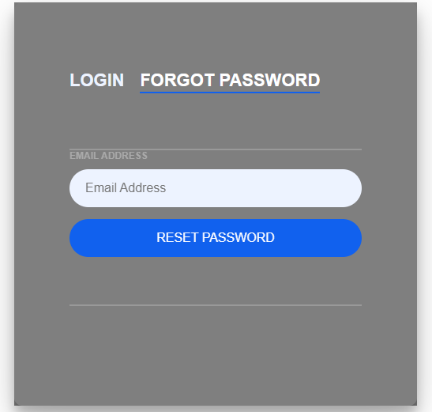
STUDENT OUTPUTS:
Click Here

Slide 36
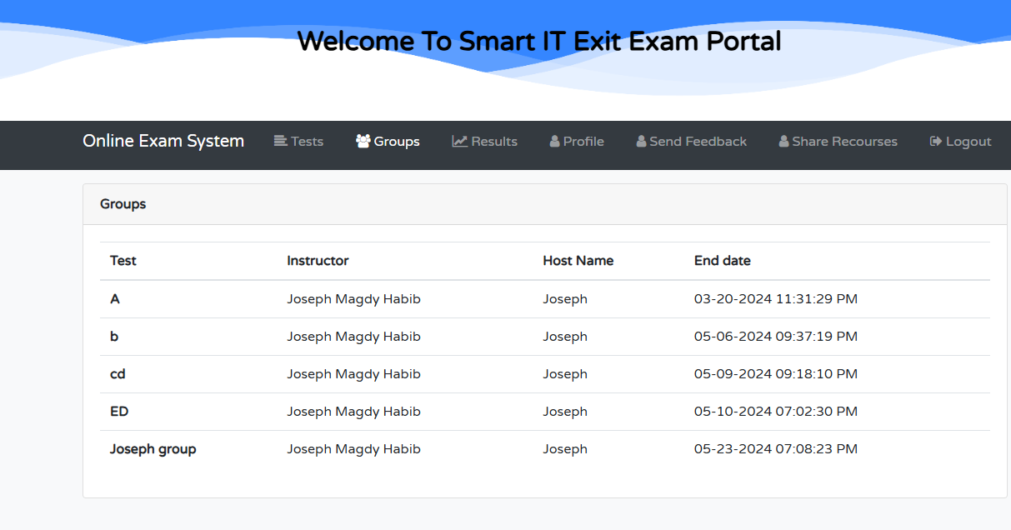
STUDENT OUTPUTS:
Click Here

Slide 37
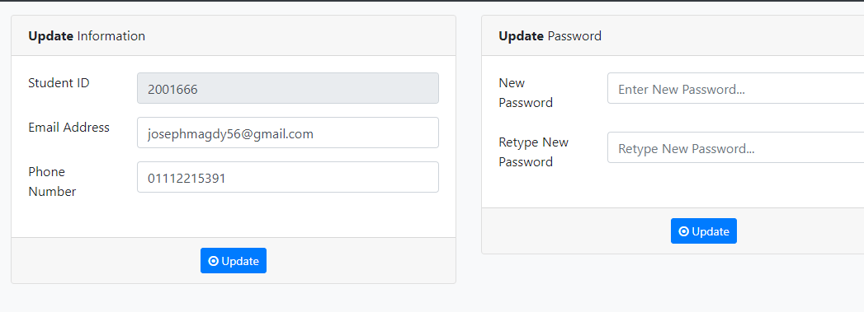
STUDENT OUTPUTS:
Update profile of student
Click Here

Slide 38
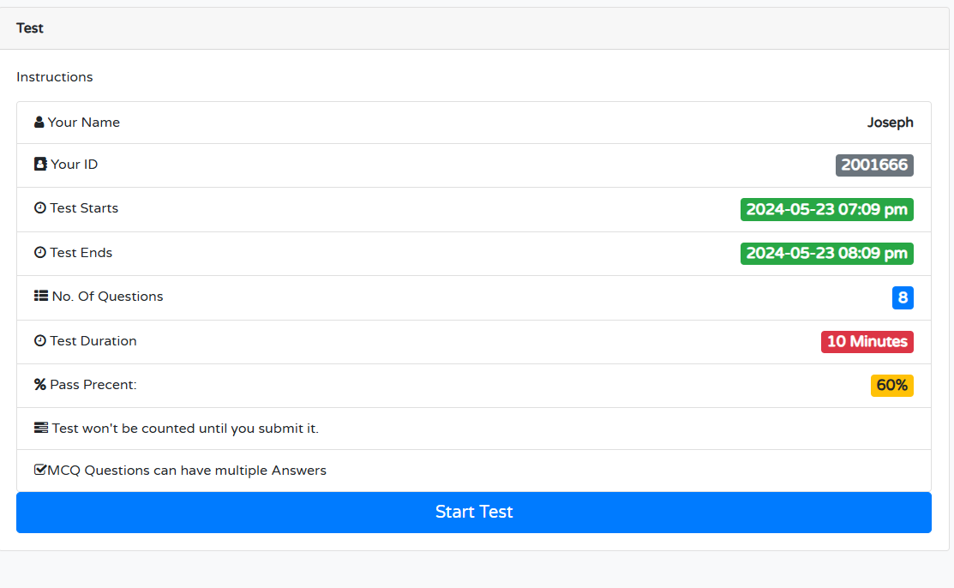
STUDENT OUTPUTS:
View the details of test
Click Here

Slide 39
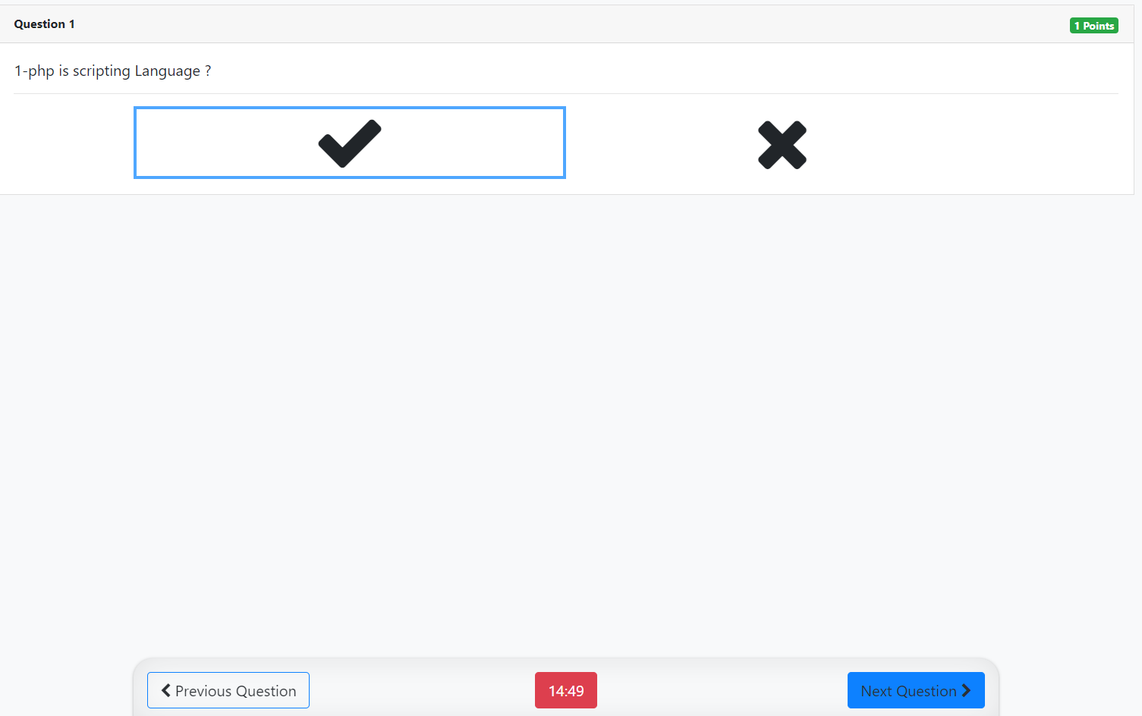
STUDENT OUTPUTS:
Click Here

Slide 40
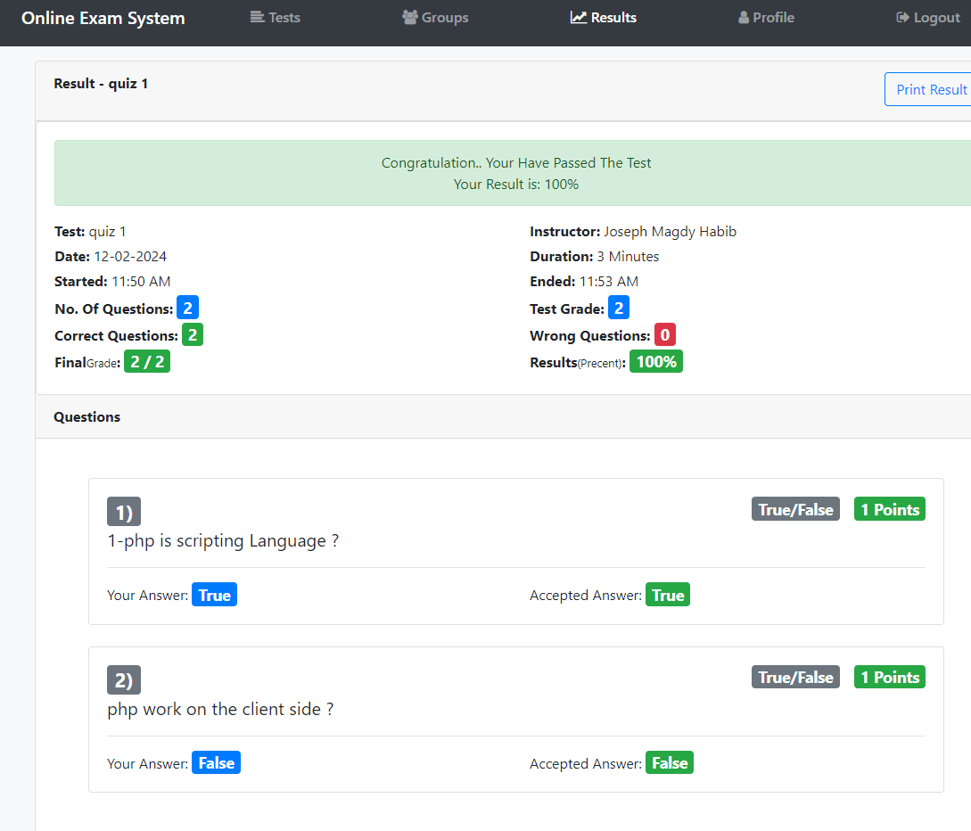
STUDENT OUTPUTS:
Click Here

Slide 41
USECASE Diagram
Click Here
Sequence Diagram

Slide 42
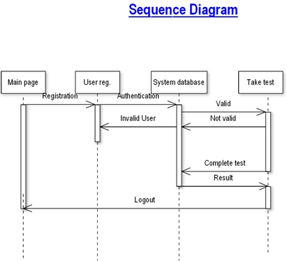

STUDENT
Click Here to Future

Slide 43

07:Future Work:
The enhancement that we can add by first term comments:
• add Pie Chart explains that How Many Students Solve a number of questions and type of question as (easy - moderate - hard) and test grade of quiz . (Dr/Ahmed ezz)

Slide 44
07:Future Work had been done
We add docs with images for users to show how to use the system and if anyone face a problem will found the solution of it .
• We add Pie Chart explains that How Many Students Solve a number of questions and type of question as (easy - moderate - hard) and test grade of quiz .
• We add a chat bot, which makes it easier for the student
• We add a survey form student to send his feedback about his Satisfied | Dissatisfied about website and express his problems on quiz
• We add Contact Us form For any User on The website If face any problem as not able to login or something went wrong on website
• We add IT Level 4 Community Student Groups to share some resources together and links of extra courses for helping each other

Slide 45
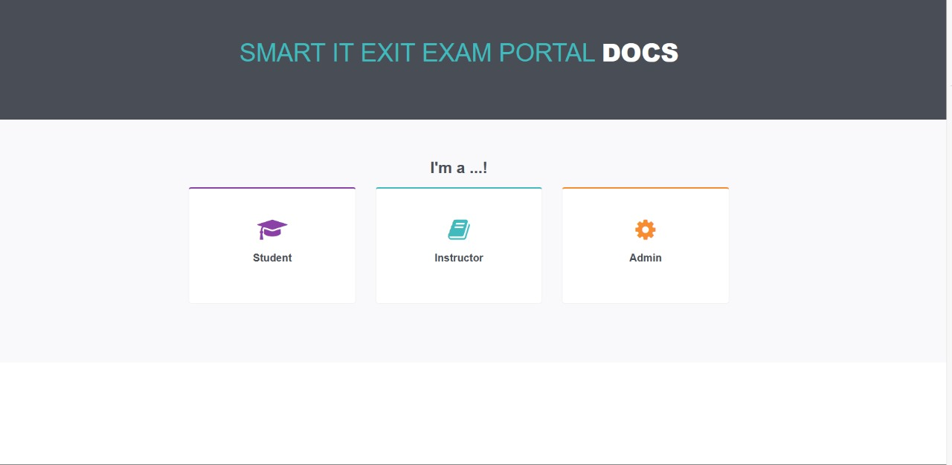
07:Future Work had been done
1-Docs

Slide 46
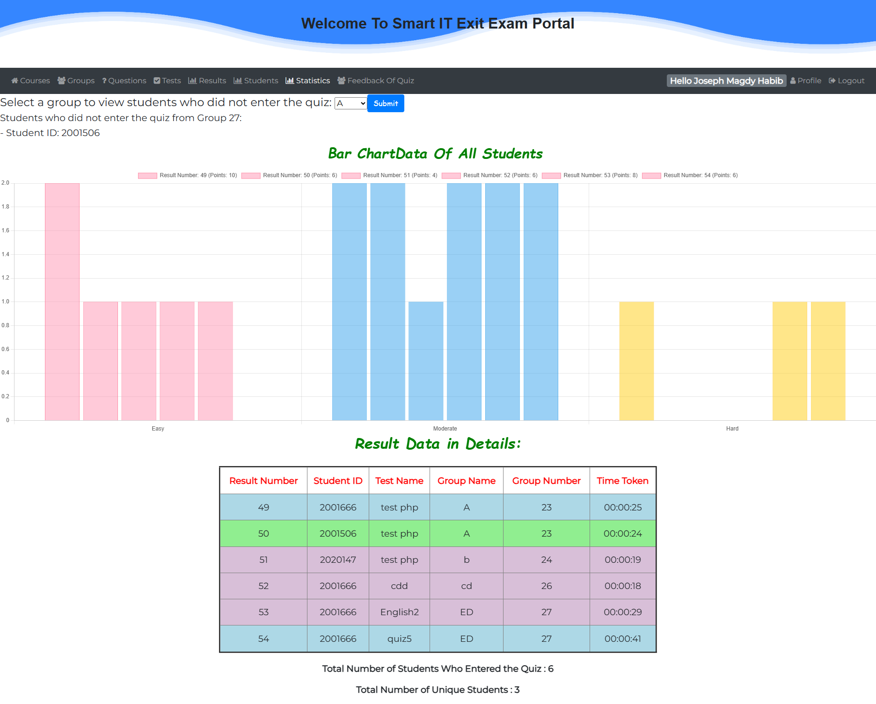
07:Future Work had been done
2-statistical

Slide 47

07:Future Work had been done
2.1- Why statistical & advantages
Scenario: An instructor wants to understand how students performed on a test to improve future teaching. Visual Summary: The pie chart provides a quick and easy-to-understand summary of how students performed on different types of questions.
Identify goal: It helps instructors see which types of questions (Easy, Moderate, Hard) students find challenging.
Adjust Teaching Methods: Based on the data, instructors can modify their teaching methods to better students' needs.
Targeted Help: Resources like tutoring or extra practice materials can be directed where they are needed most.
the instructor: can see who are the students who didn't enter the Quiz in the different groups .

Slide 48

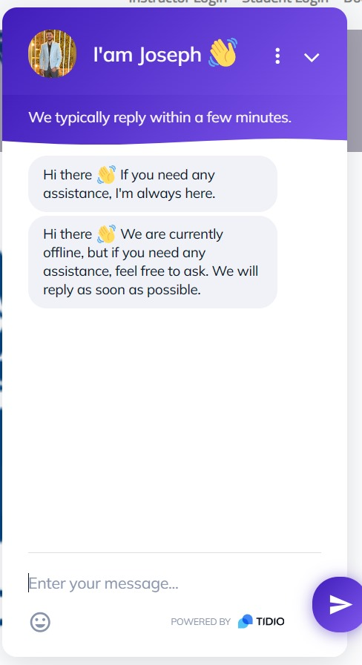

07:Future Work had been done
3-CHAT BOT.

Slide 49
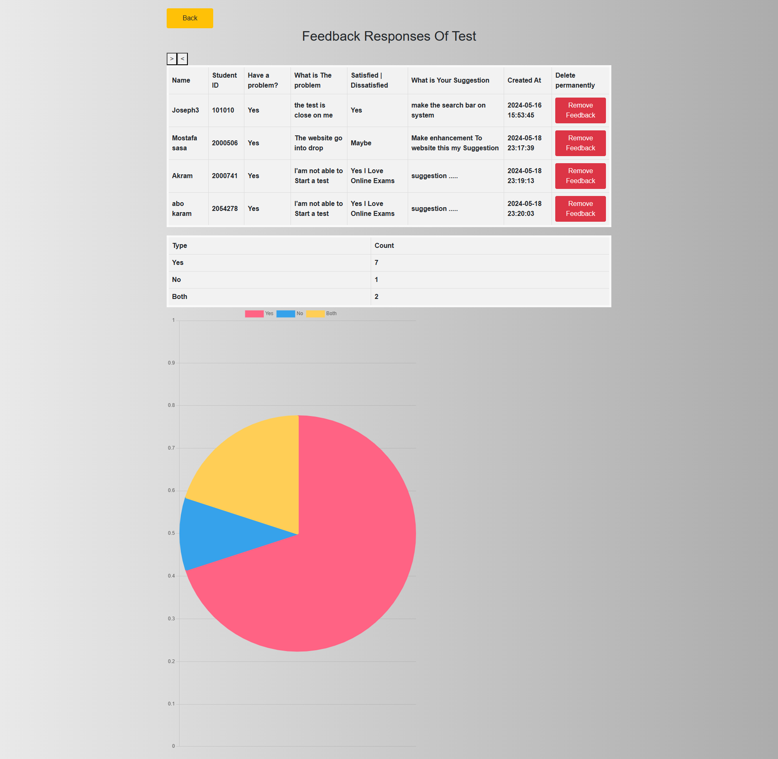
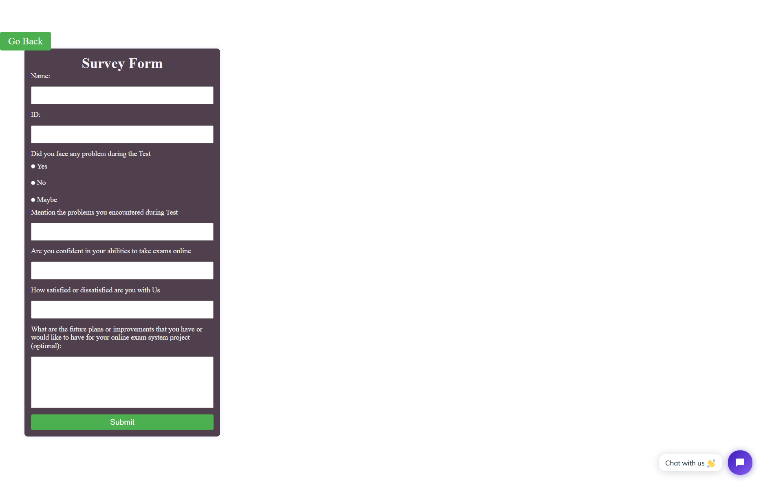
4-Survey Form Of Quiz if have a problem.

Slide 50
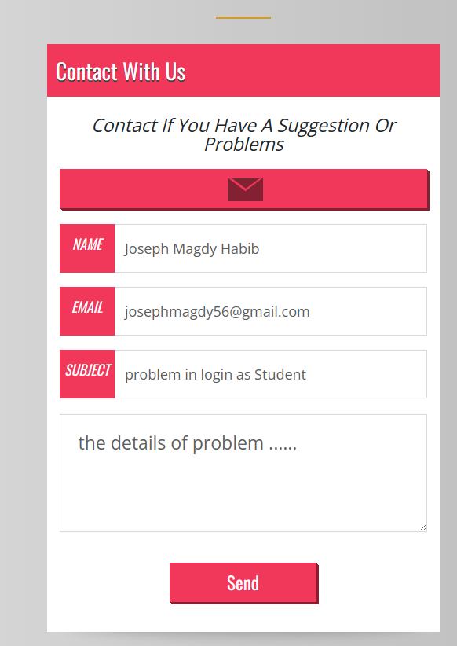
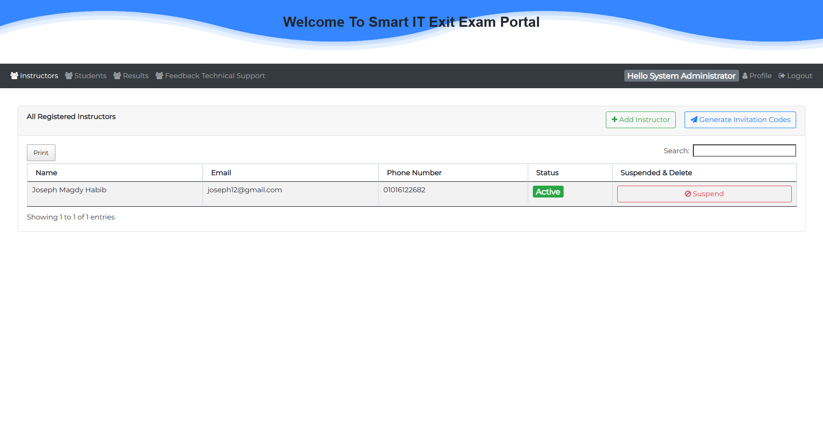
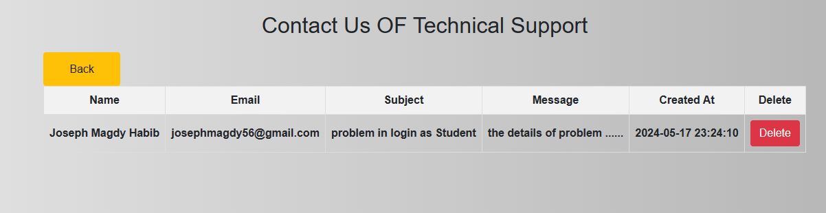
4-Survey Form Of Technical support.

Slide 51
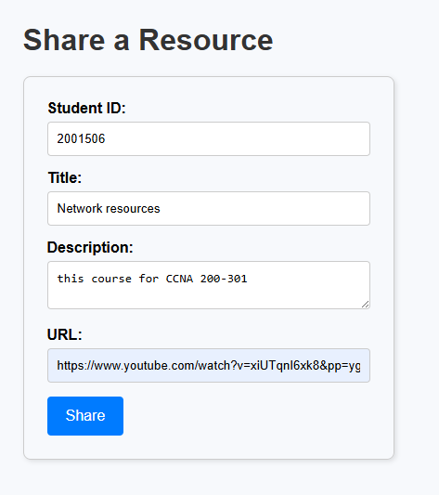
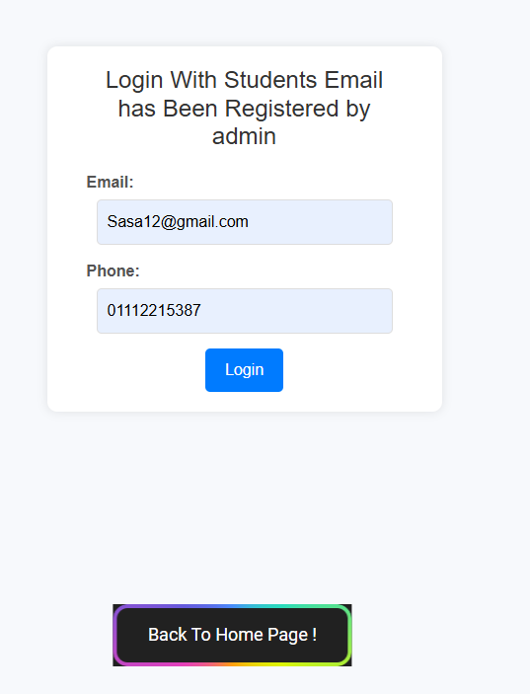
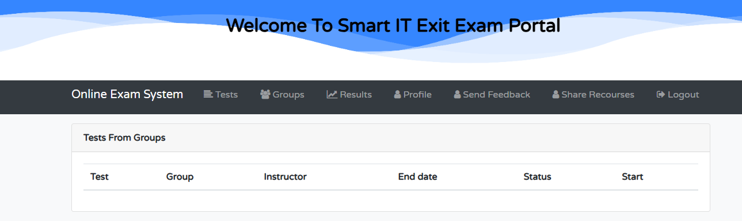
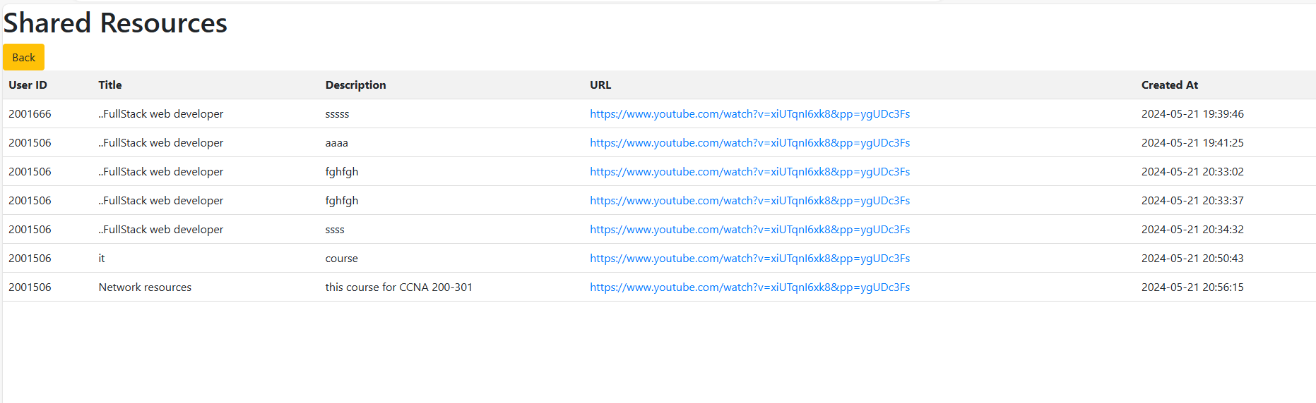

4-IT Level 4 Community Student Groups

Slide 52


4-What is the need to be more Competitive the best Smart It Exit Exam Portal in future .
add AI plays a vital role : Resource Suggestions: When students get bad results, AI can suggest videos, articles, and exercises to help them improve on their weak points.
Virtual Labs: Provide online labs where students can practice real-world skills in a safe environment.
Measuring the quality of the educational program of the system

Slide 53


I would like to thank all the students who participated in the work for this project, and Dr. Mohamed Ashour and Engineer Menna for their hard work and effort throughout the year. I also thank the distinguished doctors for hearing us and understanding the idea of the project. If you have any questions, me and all the team are ready to answer them. Thank you very much.

Slide 54



THANK
YOU

